Slide 1
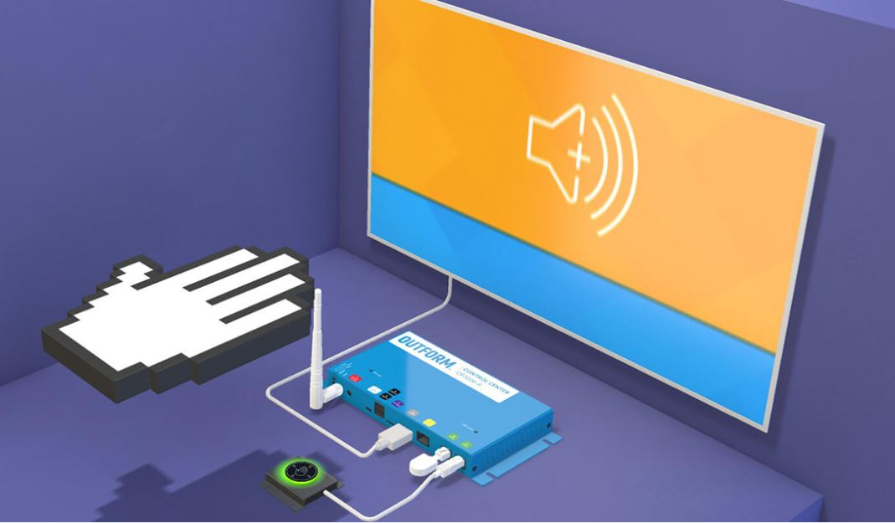

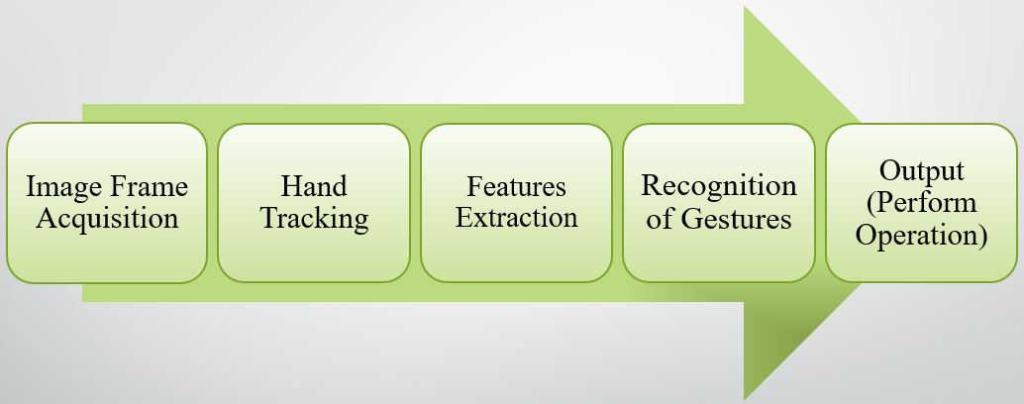



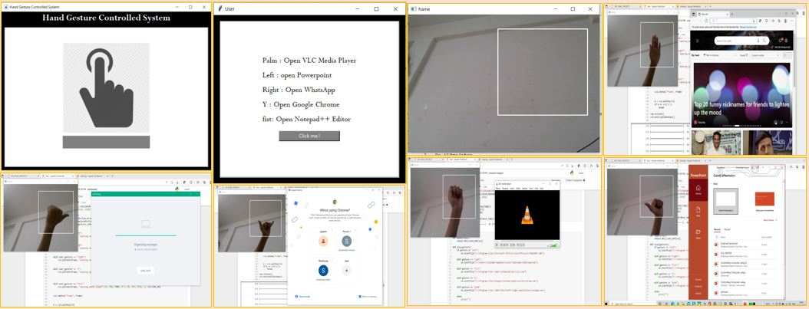
Controlling Computer using Hand Gestures
Guided by : Rajesh Prasad
Group ID: 22
Group Members [Final Year IS-2]
Pradnya Kedari (2183149), Shubhangi Kadam (2183214)
Abstract:
The presence on market of the low-cost webcams with, at least, satisfactory qualities open up new directions regarding the implementation of human computer interaction (HCI) interfaces.
Gesture is one of the most vivid and dramatic way of communications between human and computer. Hence, there has been a growing interest to create easy-to-use interfaces by directly utilizing the natural communication and management skills of humans.
Our objective is to build and train a model for feature extraction and classification of hand gestures and recognizing an action and performing an operation accordingly.
Proposed Methodology:
Result:
Link of Papers https://www.irjet.net/archives/V9/i2/IRJET-V9I2181.pdf
Conclusion and Future Scope: Hand gesture recognition used in many applications like HCI, robotics, sign language, digit and alphanumeric value, home automation, medical applications, gaming etc. Hand gestures recognition provides an interesting interaction field in a several different computer applications. This project have limited scope, but in future we can add more operations like volume up/down, scroll up/down, swipe left/right and many more, and can possible to make completely hand gestures controlling device.

